Slide 1
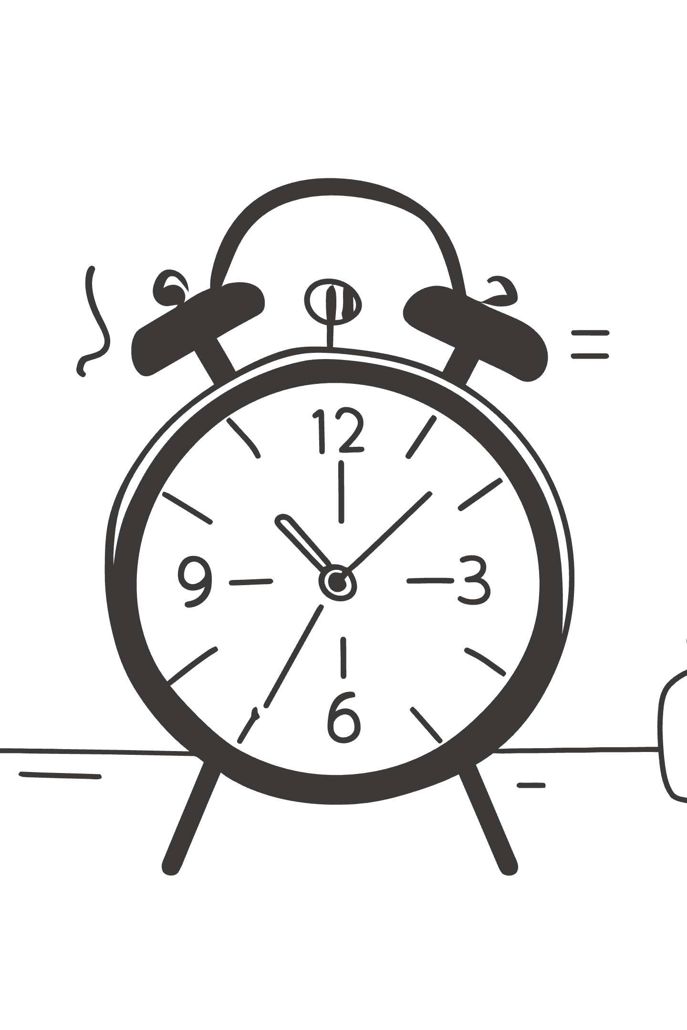
AI Readiness Scale (AIRS)
Development and Validation of a Psychometric Instrument for Assessing Enterprise AI Adoption
Doctor of Business Administration Dissertation Defense
DBA DISSERTATION
N = 523 · OCTOBER–NOVEMBER 2025

Slide 2
Agenda
Dissertation Overview
01
02
03
Research Problem & Significance
Theoretical Framework
Methodology
The adoption-value gap and three motivating gaps
UTAUT2 extended with AI Trust
Mixed-methods design, instrument development, and analytical pipeline
04
05
Key Findings
Contributions & Implications
Psychometric properties, structural model, moderation, and typology
Theory, practice, and future research roadmap

Slide 3

The Adoption-Value Gap
88%
5%
90–95%
AI Tool Usage
Value Realized
Pilots Stalled
Knowledge workers using AI tools in 2025, up from 50% in 2023
Organizations reporting measurable value from AI implementations
Generative AI pilot programs that do not progress beyond initial trials
Organizations invest heavily in AI tools yet consistently fail to realize meaningful returns — a critical problem for both scholarship and practice.

Slide 4
Three Motivating Gaps
Theoretical Gap
Measurement Gap
Practice Gap
UTAUT2 was validated for consumer mobile technologies. Whether its predictor structure holds for AI — characterized by autonomous decision-making, probabilistic outputs, and evolving capabilities — remained empirically untested.
No validated psychometric instrument existed for AI-specific adoption readiness. Existing scales addressed general technology acceptance or narrow AI applications, leaving organizations without a diagnostic tool.
Organizations lacked evidence-based frameworks to identify specific adoption barriers and design targeted interventions. Without systematic measurement, AI implementation strategies remained generic rather than responsive.

Slide 5

Chapter 1
Theoretical Framework
The study builds upon UTAUT2 — the most comprehensive validated model of technology acceptance — and extends it with an AI-specific construct to address the unique characteristics of artificial intelligence as a technology category.

Slide 6
UTAUT2 Foundation: Seven Constructs
Performance Expectancy (PE)
Effort Expectancy (EE)
Perceived improvement in job performance from using the technology
Perceived ease of learning and using the technology
Social Influence (SI)
Facilitating Conditions (FC)
Degree to which important others believe one should use the technology
Perception of available resources and support infrastructure
Hedonic Motivation (HM)
Price Value (PV)
Habit (HB)
Pleasure or enjoyment derived from using the technology
Perceived balance between benefits received and monetary cost
Extent to which technology use has become automatic

Slide 7


AI-Specific Extension: AI Trust
AI tools differ fundamentally from conventional technologies in their capacity for autonomous reasoning, opaque decision processes, and evolving behaviors.
AI Trust (TR) was introduced as an eighth construct, capturing the degree to which users believe AI systems will provide accurate, reliable information and operate in a trustworthy manner.
Key Distinction: Trust in AI is not merely confidence in a tool — it reflects users' beliefs about autonomous, probabilistic systems that may behave unexpectedly.
This extension is grounded in emerging literature identifying trust as a unique barrier to AI adoption not adequately captured by existing UTAUT2 constructs.

Slide 8
Research Questions & Hypotheses
1
2
Primary RQ
RQ2: Factorial Validity
To what extent does UTAUT2, extended with AI Trust, explain Behavioral Intention to adopt AI tools among U.S. students and professionals?
Psychometric adequacy of the extended model
3
4
RQ3: Moderation
RQ4 & RQ5
Experience and role moderation of structural paths
Behavioral intention–usage relationship and user typology based on readiness patterns
Twelve hypotheses were tested: seven core UTAUT2 path hypotheses (H1a–H1g), one AI Trust hypothesis (H2), two moderation hypotheses (H3–H4), and two behavioral validation hypotheses (H5–H6).

Slide 9

Chapter 2
Methodology
Design
Post-positivist sequential mixed-methods with quantitative primacy
Sample
N = 523 U.S. adults via Centiment topic-blinded recruitment
Period
October–November 2025 (3-week collection window)
Platform
Dual-platform validation: Python + R/lavaan 0.6.21

Slide 10
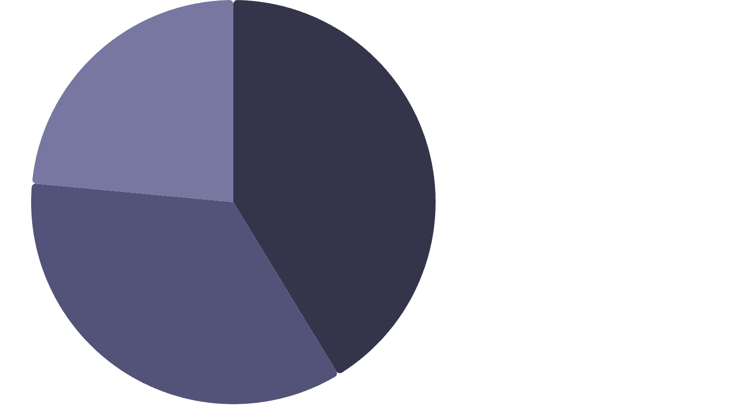
Sample Composition
Key Sampling Decisions
Topic-blinded recruitment via Centiment: respondents did not know the survey concerned AI when deciding to participate, mitigating self-selection bias.
Academic (Students)·41.3%
50/50 sample split (seed = 67, stratified by AI adoption): development subsample (n = 261) for EFA; holdout sample (n = 262) for CFA confirmation.
Professional (ICs/Freelancers)·35.18%
Leader (Managers/Executives)·23.52%
Disability representation: 68 participants (13.0%) self-reported a disability — consistent with U.S. Census Bureau estimates.

Slide 11

Instrument Development: AIRS
EFA Model Selection
Initial Pool
Final AIRS‑16
The final instrument retains 8 theoretically interpretable factors with strong psychometric properties, providing a compact yet diagnostically rich tool for organizational assessment.

Slide 12
10-Phase Analytical Pipeline
Phase 0–1
1
Sample splitting & Exploratory Factor Analysis (EFA)
2
Phase 2–3
Confirmatory Factor Analysis (CFA) & Measurement Invariance
Phase 4–5
3
Structural Equation Modeling & Mediation Analysis
4
Phase 6–7
Moderation Analysis & Behavioral Validation
Phase 8–10
5
Qualitative Content Analysis & Comprehensive Synthesis
EFA used MINRES extraction with promax rotation (item retention: primary loading ≥ .50, cross-loading gap ≥ .20, communality ≥ .30). CFA/SEM used Maximum Likelihood with Satorra-Bentler robust corrections (MLM). Bootstrap validation: 1,000 resamples.

Slide 13
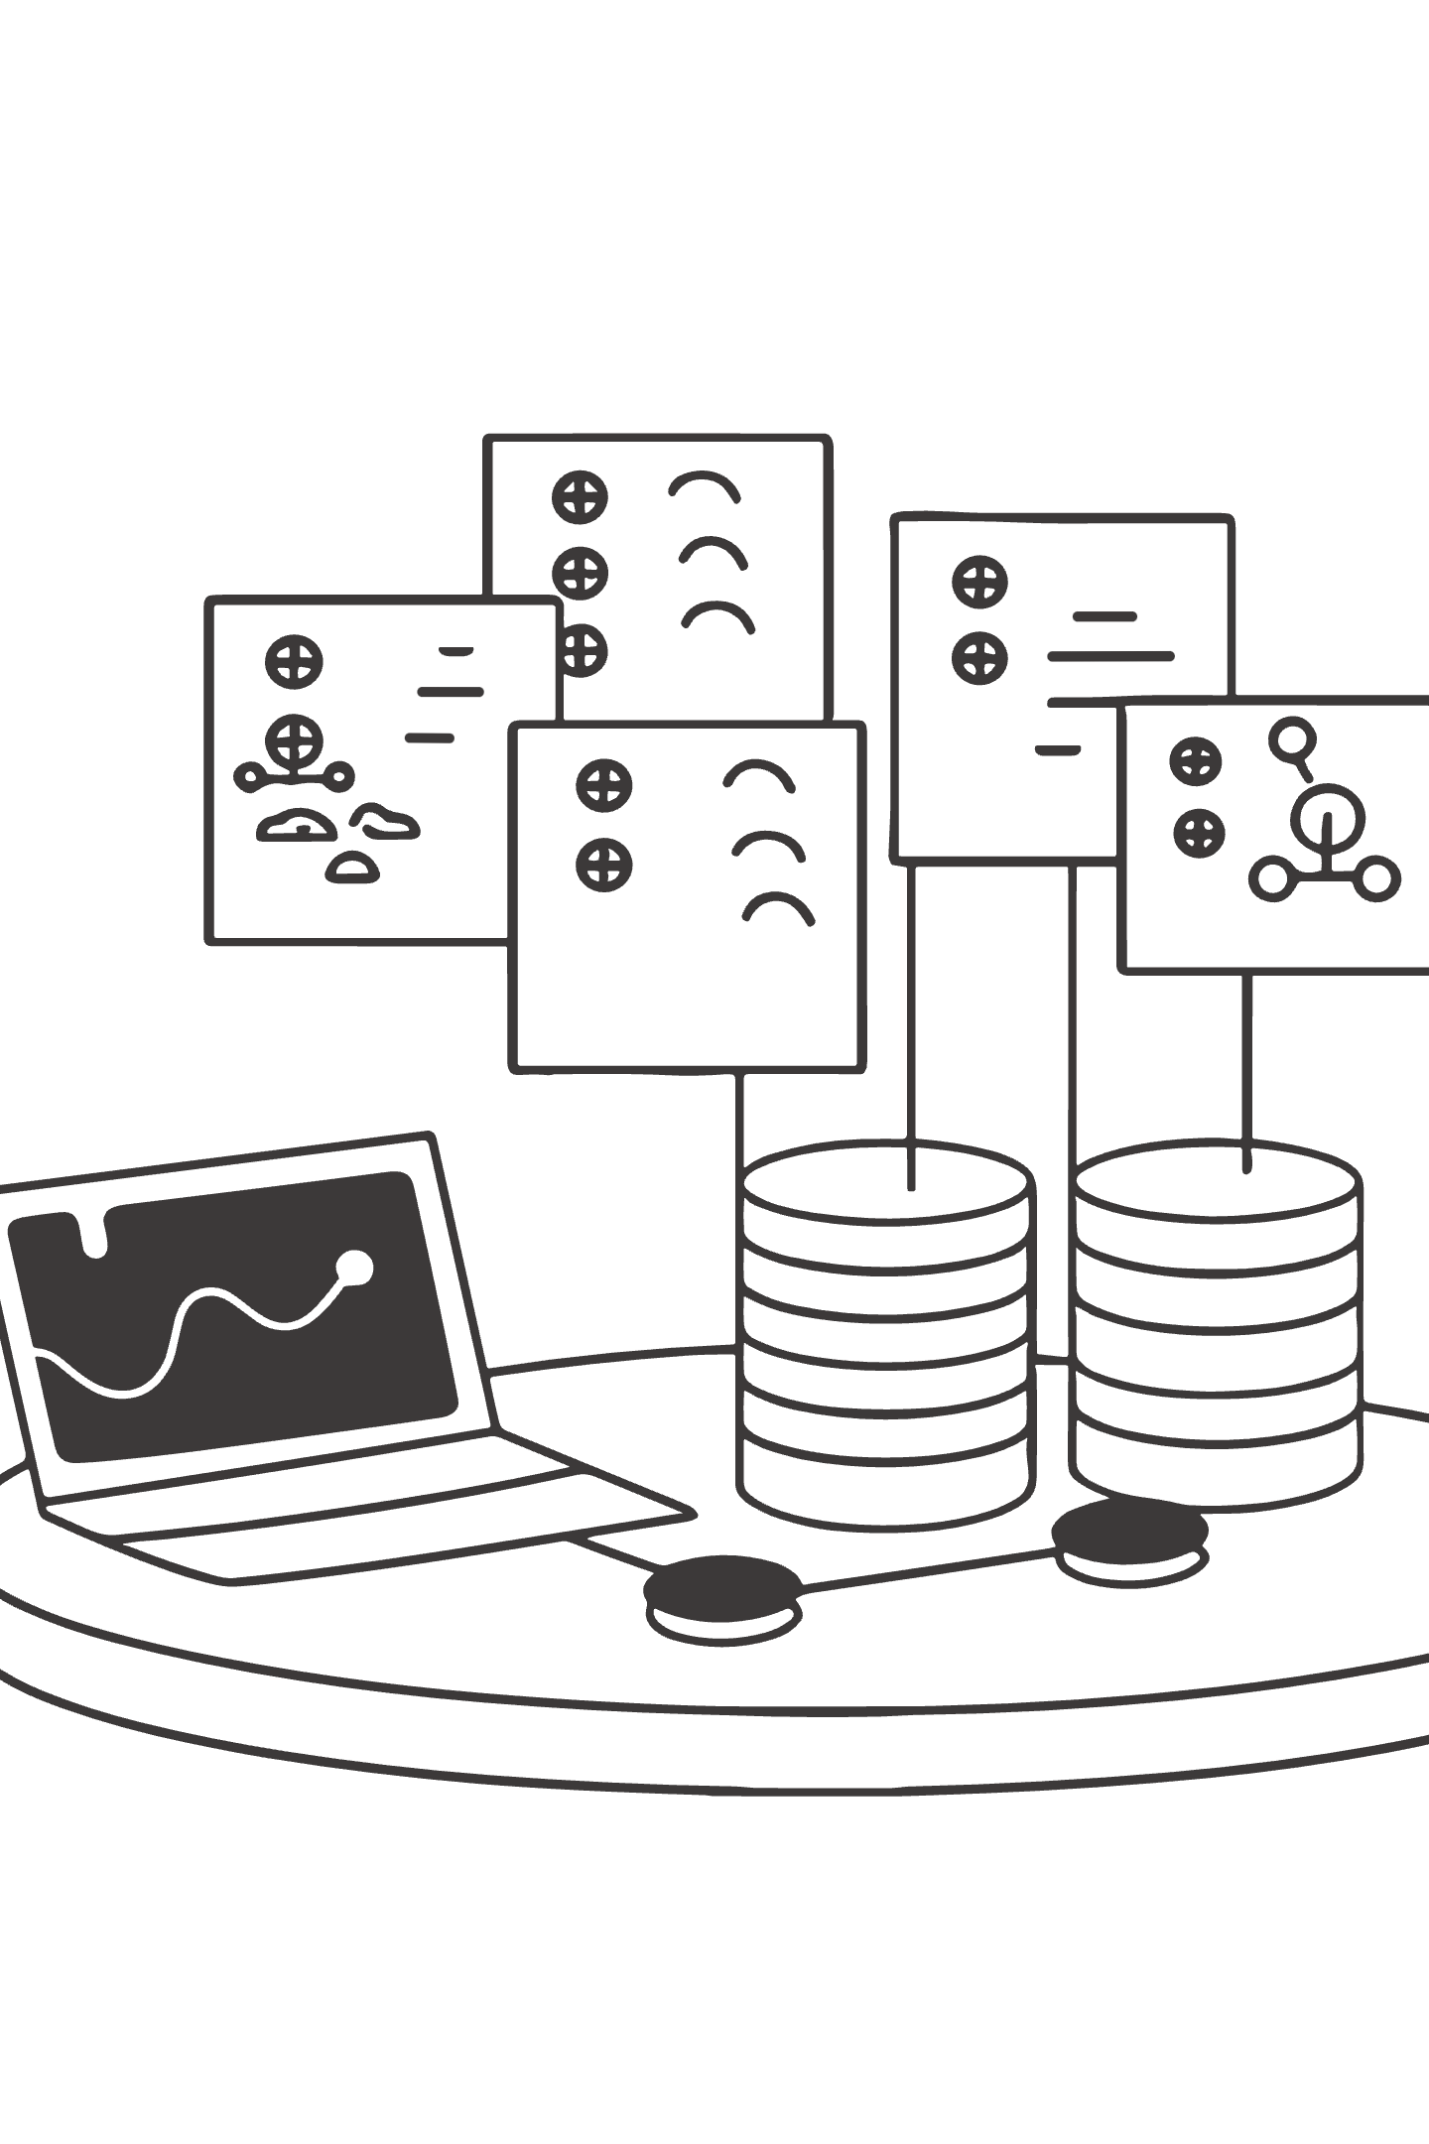
Chapter 3
Key Findings: Measurement Model
The 16-item AIRS demonstrated excellent suitability for factor analysis: KMO = .937 (superb) and Bartlett's Test χ² = 4,668.45, p < .001. No multivariate outliers were detected.

Slide 14

CFA Model Fit: Holdout Sample (n = 262)
Index
Assessment
What This Means
Value
Threshold
The 8-factor model achieved excellent fit on an independent holdout sample — a stringent test that rules out overfitting to the development data.
Cross-validation across dual platforms (Python and R/lavaan) confirmed the stability of these results, providing high confidence in the instrument's psychometric integrity.
CFI
Excellent
.975
≥ .95
TLI
Excellent
.960
≥ .95
RMSEA
Good
.065
≤ .08
SRMR
Excellent
.026
≤ .08
χ²/df
Good
2.10
≤ 3.0
Full-sample CFA confirmed: CFI = .979, TLI = .966, RMSEA = .061, SRMR = .022

Slide 15
Reliability & Convergent Validity
Factor
Cronbach's α
Composite Reliability
AVE
Status
Performance Expectancy
.863
.866
.764
✓
Effort Expectancy
.803
.805
.674
✓
Social Influence
.792
.793
.659
✓
Facilitating Conditions
.743
.750
.601
✓
Hedonic Motivation
.909
.910
.835
✓
Price Value
.882
.883
.791
✓
Habit
.909
.909
.833
✓
AI Trust
.862
.862
.758
✓
All composite reliabilities exceeded .750 and all AVE values exceeded .50, confirming convergent validity across all eight factors.

Slide 16
Discriminant Validity: HTMT Analysis
HTMT Violations (Threshold: .85)
Interpretive Context
Pair
HTMT
Status
Violations are concentrated in the PE–HM–PV triad and are structurally expected for 2-item-per-factor scales with conceptually adjacent constructs.
PE × PV
.902
Exceeds
The CFA model nonetheless demonstrated excellent overall fit. Each construct measures a distinct intervention target — organizations benefit from separately assessing performance perceptions, enjoyment, and value even when these dimensions are highly correlated.
PE × HM
.900
Exceeds
HM × PV
.904
Exceeds
HM × TR
.850
At threshold
HTMT violations do not compromise the instrument's diagnostic purpose.

Slide 17

Chapter 4
Structural Model Results
89.7%
12
5
Variance Explained
Hypotheses Tested
Supported
R² for Behavioral Intention — an exceptionally high value indicating AIRS captures the vast majority of systematic variance in AI adoption intention
Across UTAUT2 core paths, AI Trust extension, moderation, and behavioral validation
Hypotheses fully or marginally supported, with 3 partially supported and 4 not supported

Slide 18
Primary Path Coefficients
H
Path
β
p
Bootstrap 95% CI
Result
H1a
PE → BI
−.028
.791
[−.234, .178]
Not Supported
H1b
EE → BI
−.008
.875
[−.108, .092]
Not Supported
H1c
SI → BI
.136
.024
[.018, .254]
Supported*
H1d
FC → BI
.059
.338
[−.062, .180]
Not Supported
H1e
HM → BI
.217
.014
[.044, .390]
Supported*
H1f
PV → BI
.505
<.001
[.352, .658]
Confirmed — Strongest
H1g
HB → BI
.023
.631
[−.071, .117]
Not Supported
H2
TR → BI
.106
.064
[−.006, .218]
Marginal
*z-test significant; bootstrap CIs include zero — interpreted as suggestive rather than conclusive. Bootstrap validation (1,000 resamples): only Price Value's path was confirmed as fully robust.

Slide 19
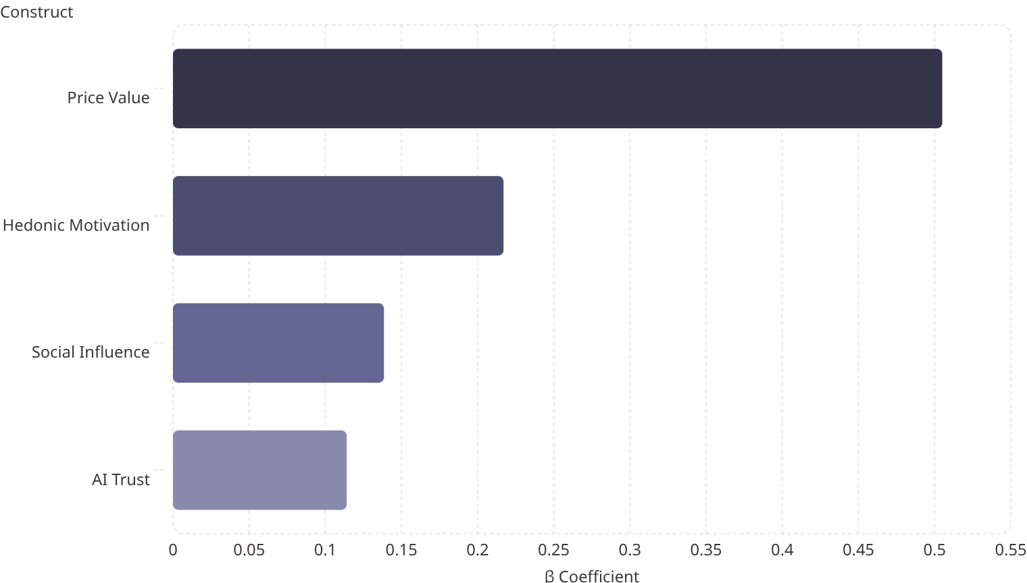
The Price Value Dominance Finding
A Striking Reversal
Interpretive Logic
Blut et al. (2022) meta-analysis across 417+ UTAUT studies:
Performance Expectancy dominant (weighted β = .39)
When users already regard AI's usefulness as a baseline expectation — supported by uniformly high PE means in this sample — adoption decisions shift to whether perceived benefits justify the financial investment.
Present study:PE non-significant (β = −.028)
Price Value dominant (β = .505)
This reversal suggests AI tools represent a distinct technology category where cost-value outcomes have displaced perceived utility as the primary adoption driver.

Slide 20
AI Trust: Diagnostic Retention Rationale
1
2
3
Unique Diagnostic Capability
Statistical Power Consideration
Parsimony vs. Utility
Trust provides organizational insight that other constructs cannot detect — identifying trust deficits that require targeted confidence-building interventions
Detecting the marginal effect (β = .106) at 80% power requires n > 600; the present N = 523 yields ~68% power — the effect is theoretically relevant but underpowered
Model comparison favored the 7-factor model on parsimony (ΔAIC = +2.01), but the 8-factor AIRS is retained as the recommended diagnostic instrument for organizational assessment

Slide 21
Moderation Effects
Experience Moderation (H3: Partially Supported)
Population Moderation (H4: Partially Supported)
Professional experience significantly moderated the HM → BI path (β = .136, p = .007). Professionals with 4+ years weight hedonic motivation more heavily as experience grows.
Hedonic Motivation showed significant population moderation (p = .041):
Academic group: HM β = 0.449 (strong positive)
Professional group: HM β = −0.301 (negative)
Usage-group comparison:
Low-usage group: Performance Expectancy mattered (β = .371, significant)
High-usage group: Price Value dominated (β = .878, significant)
Academics adopt AI partly for the enjoyment of exploration and learning. Professionals may view the "enjoyment" dimension as irrelevant or counterproductive to task-focused work.
Adoption drivers evolve with experience: new users focus on utility; experienced users focus on value.
Price Value remained dominant for both groups.

Slide 22
Behavioral Validation
Intention–Usage Correlation (H5: Supported)
Individual Tool Correlations
Role Differences (H6: Supported)
ChatGPT × BI: ρ = .57
Microsoft Copilot × BI: ρ = .54
Google Gemini × BI: ρ = .52
One-way ANOVA confirmed a clear hierarchy: Leaders > Professionals > Academics across tool breadth (η² = .066), usage frequency (η² = .078), and usage intensity (η² = .058).
Behavioral Intention was strongly associated with actual AI tool usage frequency: Spearman ρ = .69, p < .001, confirming AIRS measures a construct with real behavioral consequences.
Leaders demonstrated particularly elevated Microsoft Copilot usage (Cohen's d = 1.14 vs. Professionals), likely reflecting enterprise licensing and workflow integration.

Slide 23

User Typology: Three Segments
🚀 AI Enthusiasts — 31%
⚖️ Moderate Users — 47%
Early adopters with high engagement across all dimensions. Mean BI = 4.23. Deploy as change champions and peer influencers.
Pragmatic users near population means. Respond to value demonstrations and social proof from peers.
🛑 AI Skeptics — 22%
Resistant users with below-mean readiness. Mean BI = 1.71. Require trust-building and anxiety-reduction before engagement strategies will succeed.
K-means cluster analysis (k = 3, silhouette = 0.271) explained 65.9% of BI variance (F(2,520) = 503.47, p < .001, η² = .659), confirming a clear readiness gradient.

Slide 24
Hypothesis Outcome Summary
Category
Supported
Partial
Not Supported
The Pattern Is the Finding
The distribution of supported vs. unsupported hypotheses reveals that AI adoption follows a different predictor structure than traditional technology adoption — with cost-value perceptions displacing utility perceptions as the primary driver.
UTAUT2 Core (H1a–g)
3 (43%)
0
4 (57%)
AI Extension (H2)
0
1 (marginal)
0
Moderation (H3–H4)
0
2
0
Behavioral (H5–H6)
2 (100%)
0
0
Total
5 (42%)
3 (25%)
4 (33%)

Slide 25

Chapter 5
Theoretical Contributions

Slide 26
Contribution 1 & 2: UTAUT2 Extension & PV Dominance
First Empirical Validation of UTAUT2 for AI
AI as a Distinct Technology Category
This is the first study to empirically validate UTAUT2 for AI tool adoption with a purpose-built psychometric instrument. The 8-factor structure demonstrates UTAUT2's architecture applies to AI contexts, but predictor importance shifts substantially — four traditional predictors (PE, EE, FC, HB) were non-significant.
Price Value dominance (β = .505) challenges decades of UTAUT research positioning Performance Expectancy as the primary driver. In AI contexts, utility may function as a baseline expectation rather than a differentiating factor, with adoption shaped more strongly by perceived cost-benefit ratios.

Slide 27
Contributions 3–5: Career Stage, Typology & Industry Validation
1
Career Development Integration
2
Three-Segment User Typology
3
Converging 2025 Industry Validation
The HM → BI moderation (p = .007) and population moderation (Academic β = 0.449 vs. Professional β = −0.301) establish that adoption mechanisms are career-stage dependent — a novel bridge between career development theory and technology acceptance.
The empirically derived typology (Enthusiasts, Moderate Users, Skeptics) explained 65.9% of BI variance, providing a segmentation framework grounded in validated psychometric dimensions rather than ad hoc categorization.
McKinsey (N = 1,993), BCG, MIT Media Lab, Gartner, Deloitte, and Capgemini each reported patterns broadly consistent with AIRS findings — including centrality of perceived value, heterogeneous readiness, and limits of one-size-fits-all strategies.

Slide 28
Contribution 6: Four Adoption-Value Gap Mechanisms
Value Communication Misalignment
Heterogeneous Readiness
Organizations emphasize capability rather than ROI, failing to address the dominant PV predictor
Treating the workforce as monolithic when 22% are Skeptics requiring fundamentally different intervention
Neglected Affective Barriers
Context-Inappropriate Frameworks
Anxiety and hedonic motivation are ignored in favor of rational-utilitarian framings
Generic technology adoption strategies fail to account for AI's distinctive characteristics as a technology category

Slide 29

Chapter 6
Practical Implications
The AIRS findings translate directly into evidence-based recommendations for organizations deploying AI tools, AI tool designers, trainers, and policymakers.

Slide 30
For Organizations: Eight Practitioner Recommendations
01
02
Diagnose Before Prescribing
Lead with Value
Conduct baseline AIRS assessment before designing AI adoption initiatives
Frame AI in terms of cost-benefit returns (PV dominance), not capability showcases
03
04
Attend to Affective Barriers
Leverage Social Influence
Hedonic motivation and anxiety influence adoption beyond rational calculations
Peer champions and leadership endorsement are the third significant predictor (SI β = .136)
05
06
Differentiate by Experience
Monitor Trust Continuously
Novice and experienced users respond to different adoption drivers
Trust functions as a diagnostic indicator and necessary condition, not just a predictor
07
08
Design for Accessibility
Segment the Workforce
Universal design principles reduce anxiety-driven non-adoption among users with disabilities
Any single intervention strategy will fail for at least one-third of the workforce

Slide 31



Segment-Specific Intervention Strategy
AI Skeptics (22%)
Moderate Users (47%)
AI Enthusiasts (31%)
Address trust barriers and anxiety before engagement. Generic training will not move this group.
Provide value demonstrations and social proof from peers. Workflow integration and ROI evidence are key.
Deploy as change champions and peer influencers. Provide access to advanced capabilities and mentorship structures.
For AI tool designers: manage pricing and perceived value explicitly, and treat accessibility as an adoption condition — not merely an inclusion issue.

Slide 32

Special Section
Neurodiversity & Disability Insights
The AIRS dataset includes 68 participants (13.0%) who self-reported a disability — sufficient for exploratory between-group analysis and among the most practically salient findings in the dissertation.

Slide 33
Disability–Anxiety Association: Core Finding
Statistically Significant Effect
Coherent Disadvantage Profile
Participants with disabilities reported significantly higher AI-related anxiety than non-disabled participants:
Across all 8 UTAUT2 constructs, participants with disabilities showed consistently lower scores on every positive adoption construct and higher anxiety — a uniform directional pattern constituting coherent disadvantage rather than random noise.
Disability group: M = 2.89, SD = 1.08
Non-disability group: M = 2.48, SD = 0.96
t(521) = 2.76, p = .006, Cohen's d = 0.36
Hedonic Motivation also reached significance (d = .28, p = .030): current AI tools are less enjoyable for users with disabilities — pointing to accessibility failures in existing AI products.
Notably, this finding emerged from AI Anxiety items that were subsequently excluded from the final AIRS-16 due to inadequate psychometric properties — suggesting the true effect may be larger than observed.

Slide 34
Disability Findings: Four Interpretive Threads
Anxiety Reflects Lived Experience
HM Suppression Is a Design Problem
For users who have repeatedly encountered inaccessible interfaces or algorithmic bias, elevated anxiety about AI is a rational response to historical exclusion — not a deficit to be corrected.
The significant HM gap (d = .28) implies current AI tools are less enjoyable for users with disabilities — pointing to accessibility failures, not user deficits.
AI Anxiety Construct Needs Redesign
Universal Design as Adoption Accelerator
The AIRS-28 expansion should prioritize redesigning anxiety items using neurodiversity-informed language distinguishing displacement anxiety from accessibility-barrier anxiety.
Making AI tools more accessible reduces anxiety-driven non-adoption broadly — the "curb cut effect" applied to AI adoption benefits the entire user population.

Slide 35
Chapter 7
Limitations
Methodological
Measurement & Scope
Cross-sectional design: Prevents causal inference about direction of relationships or how adoption intentions evolve over time
Two items per factor: Constrains reliability and contributes to elevated inter-factor correlations
Self-reported intention: BI-Usage correlation (ρ = .69) confirms meaningful association, but intention does not perfectly predict behavior
Four dropped constructs: Voluntariness, Explainability, Ethical Risk, and AI Anxiety warrant item redesign and re-investigation
Western sample: All U.S.-based participants; AI adoption patterns may differ substantially in non-Western contexts
Panel sampling: Centiment panel may not perfectly represent the broader U.S. population

Slide 36

Chapter 8
Future Research Roadmap

Slide 37
Four-Phase Research Agenda
Phase 2: Longitudinal & Cross-Cultural Validation (2026–2028)
Phase 1: AIRS-28 Development (2026–2027)
Expand from 16 to 28 items (3–4 per factor) to improve reliability and resolve discriminant validity concerns. Redesign Explainability, Ethical Risk, and AI Anxiety items. Target: eliminate all HTMT violations.
12-month longitudinal panel to track readiness profile evolution. Simultaneously validate AIRS across non-Western cultural contexts to establish cross-cultural measurement invariance.
Phase 4: Comprehensive Prediction System (2029+)
Phase 3: Intervention Framework Development (2028–2029)
Integrate AIRS with behavioral data, organizational context measures, and industry-specific moderators to build a comprehensive AI readiness prediction and monitoring system.
Design and test AIRS-informed organizational change programs targeted at each user segment. Test whether AIRS-guided interventions outperform generic AI training approaches.

Slide 38
Seven Scholar Recommendations
Larger samples (n > 600) to increase power for multi-group and moderation analyses
Improved AI-specific measures with 3–4 items per dimension to resolve HTMT violations inherent in 2-item scales
PV dominance investigation — replicate and explain why Price Value overtakes Performance Expectancy specifically in AI contexts
Career development integration — study how adoption mechanisms change across career stages (student → early → mid → senior)
Typology validation — confirm the three-segment structure in independent samples and test whether typology membership predicts actual adoption behavior
Cross-cultural replication — establish measurement invariance across non-Western contexts
Longitudinal designs — move beyond cross-sectional snapshots to track readiness trajectories and determine whether AIRS scores predict future behavior

Slide 39
Appropriate Reliance & 2026 Contextual Developments
Calibrated AI Reliance
Three 2026 Landscape Shifts
A distinctive future direction concerns the paradox that optimizing AI adoption may inadvertently increase over-reliance. The AETHER group's Calibrated AI Reliance (CAIR) and Calibrated Self-Reliance (CSR) constructs suggest the goal should be appropriate adoption — knowing when to use AI and when to rely on human judgment.
DeepSeek R1: Open-source frontier capabilities change the PV calculation entirely — no longer exclusive to well-resourced organizations
Agentic AI: Systems operating with greater autonomy raise new trust and control questions beyond the original AIRS scope
EU AI Act: Enforcement timeline introduces regulatory compliance as a new adoption consideration absent from the current UTAUT2 framework
This reframing from "more adoption is better" to "calibrated adoption is optimal" represents an important evolution of the research program, also addressed in The Life of Alex Finch (AlexBooks, March 2026).

Slide 40

Chapter 9
AIRS Enterprise Platform
AIRS Enterprise (airs.correax.com) translates the validated AIRS-16 instrument into a production SaaS platform — delivering practical assessment and remediation tools to organizations while enabling longitudinal data collection at scale.

Slide 41
Platform Core Capabilities
5-Minute Assessment
AI-Personalized Guides
Interactive AIRS-16 with progress tracking, save/resume, and smart follow-up questions. Composite AIRS score (8–40) with demonstrated validity (r = .876).
Streaming LLM-generated action plans (3–5 pages) tailored to individual profile and career context via Azure OpenAI GPT-4o-mini. Available in 29 languages.
Results Visualization
Organization Management
Animated gauge, 8-axis construct radar chart, and typology badge with actionable context. Three-segment classification at 94.5% accuracy.
Team analytics, department/role segmentation, CSV exports, impact reporting, and longitudinal pre/post assessment comparison with trend analysis.
Technology Stack: Next.js 16.1, React 19, Prisma ORM with PostgreSQL, Microsoft Entra ID authentication, Azure App Service Premium (P2v3) with VNet integration and managed identity — no stored secrets.

Slide 42
Three Intervention Frameworks by Typology
TRANSFORM Framework
REDESIGN Framework
AMPLIFY Framework
Skeptics (AIRS ≤ 20)Trust-building through graduated autonomy — starting with low-risk AI tasks, demonstrating reliability through small wins, progressively expanding scope. Emphasizes explainability and human-in-the-loop safeguards.
Moderate Users (AIRS 21–30)Workflow integration and ROI demonstration — identifying specific processes where AI adds measurable value, providing social proof through peer success stories, building competence through structured skill development.
Enthusiasts (AIRS > 30)Champion network activation — leveraging high-readiness individuals as change agents, providing access to advanced AI capabilities, and creating mentorship structures that accelerate adoption across the organization.

Slide 43
Construct-Specific Interventions
Construct
Barrier Indicator
Evidence-Based Intervention
Price Value
Low perceived ROI
TCO analysis workshops, pilot-to-proof ROI tracking, phased investment models
Hedonic Motivation
Low engagement
Gamification elements, AI sandboxes for exploration, social learning communities
Social Influence
Insufficient advocacy
Peer champion programs, leadership endorsement campaigns, success story sharing
AI Trust
Reliability concerns
Explainability tools, human-in-the-loop with graduated autonomy, transparent error reporting
Effort Expectancy
Usability barriers
Guided onboarding, contextual help systems, progressive complexity
Habit
Low integration
Default AI-assisted workflows, reminder systems, routine integration coaching

Slide 44

Longitudinal Research Design: AIRS Enterprise
T2 Three Months
T4 Twelve Months
T1 Baseline
T3 Six Months
Assess short-term stability and change
Initial measurement and profiling
Evaluate intervention responsiveness
Measure long-term predictive validity
Every organizational deployment generates structured data (8 construct scores, composite AIRS score, typology classification, demographic context) feeding directly into a normative benchmarking database targeting N = 300–500+ per population group across 8+ target groups (2026–2028).

Slide 45
Research-Practice Bridge
Closing the Implementation Gap
Three Complementary Paths
Instead of the familiar pattern in which an instrument is developed, published, and then rarely operationalized, AIRS pairs the validated instrument with a platform that evolves alongside it. Every organizational deployment strengthens the normative database; every research finding improves intervention recommendations.
AIRS-16 Instrument: Validated psychometric tool for academic and organizational use
AIRS Enterprise Platform: Production SaaS delivering assessment, personalization, and longitudinal tracking
The medium-term strategy (1–3 years) focuses on building a benchmark database. The longer-term goal (3–5 years) is to establish AIRS as a recognized AI readiness standard through academic use, organizational partnerships, and integration with enterprise HR and LMS systems.
The Life of Alex Finch (AlexBooks, March 2026): Public-facing narrative on appropriate reliance, over-reliance, and preservation of human judgment
Together, these create complementary paths for advancing the research across academic, organizational, and public audiences.

